Slide 1


File Overview: -File Naming -File Structure -File Types
By: Abhilekh Subedi

Slide 2

Introduction to Files
Fundamental concept used to store, organize, and manage data
Named collection of related data that is recorded on secondary storage
Files are logical units of information created by processes
Each file is assigned a name at creation and remains accessible even after the originating process terminates

Slide 3
Need for Files
Process have limited storage within their address space, which is insufficient for large record keeping applications
Data stored in a process’s memory is lost when the process terminates, making it unreliable for long-term storage
Multiple processes often need simultaneous access to shared data, which isn’t possible with process-bound storage
File systems solve these issues by providing large, persistent, and concurrent data storage independent of individual process

Slide 4

File Naming
Files are logical units of information created by processes, each file is assigned a name at creation and remains accessible even after the originating process terminates.
File naming rules vary by system, but most operating systems allow names to consist of strings of 1 to 8 letters with many systems also permitting digits and special characters in file names.
Modern file systems often support longer file names, with many allowing up to 255 characters, providing greater flexibility in naming conventions.
Files persist beyond the lifecycle of the creating process, enabling other processes to access them using their assigned names.
Naming scheme varies in each file system.

Slide 5
FAT(File Allocation Table)
Common in USB drives and SD cards
Original Format: 8.3 filename format:
8 characters for the name, 3 characters for the extension (e.g., FILE1234.TXT)
Long File Name (LFN) Support: Up to 255 characters
Character Restrictions:
Invalid: \ / : * ? " < > | + , ; = [ ]
Case-insensitive but case-preserving (e.g., saves File.txt but treats it as file.txt)
No support for Unicode in older FAT versions; FAT32 with LFN supports Unicode (UTF-16)

Slide 6
ext4(Fourth Extended Filesystem)
Used in most Linux distribution
Max Filename Length: 255 bytes (UTF-8 encoded; fewer characters if multibyte)
Character Restrictions:
Only / and the null character \0 are disallowed
Case-sensitive (e.g., File.txt ≠ file.txt)
Fully supports Unicode (UTF-8)

Slide 7
NTFS(New Technology File System)
Max Filename Length: 255 characters (Unicode supported)
Character Restrictions:
Invalid: \ / : * ? " < > |
Reserved filenames: CON, PRN, AUX, NUL, COM1–COM9, LPT1–LPT9 (regardless of extension)
Case-insensitive by default, but case-preserving

Slide 8
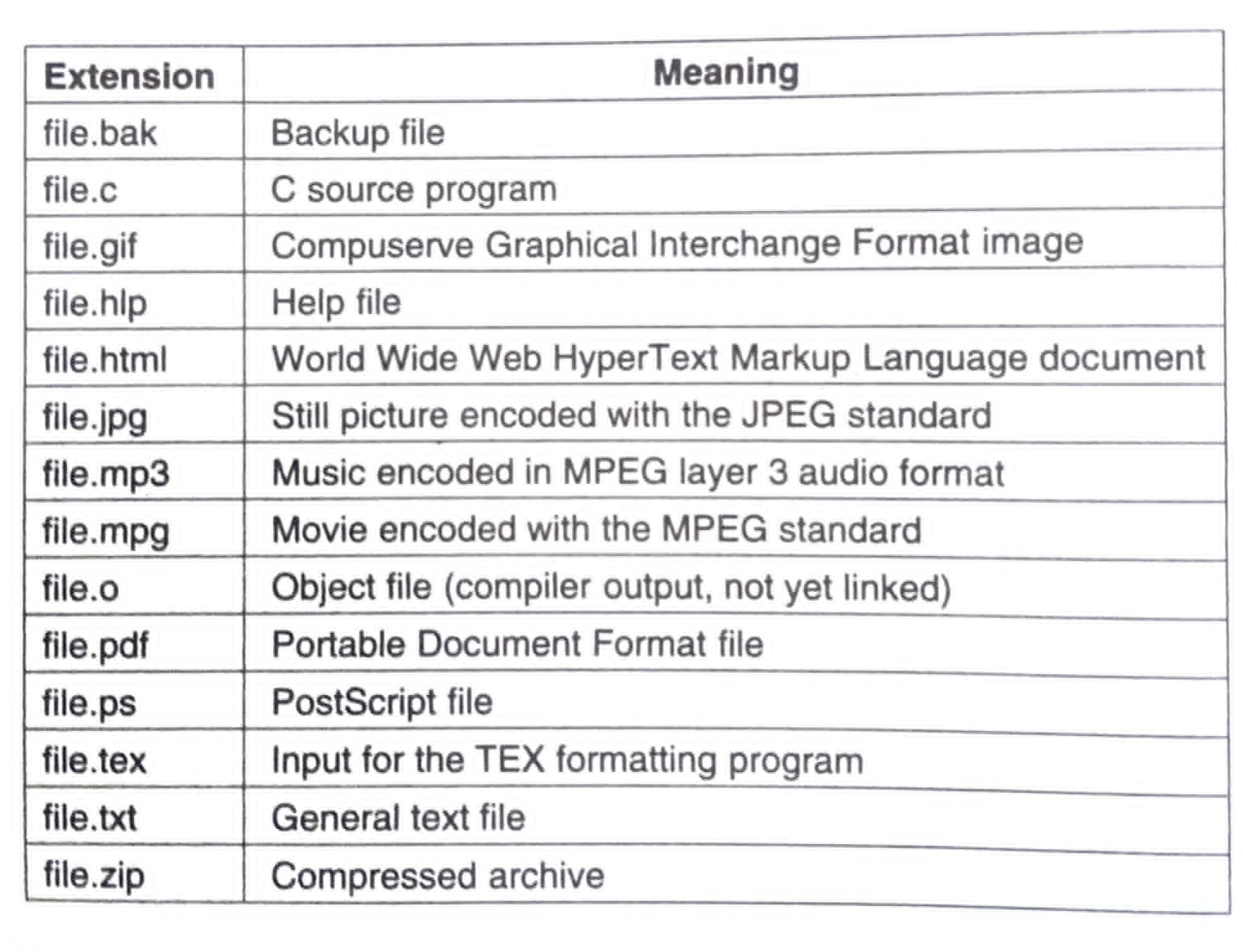
File Extensions

Slide 9
File Structure
Helps keep data organized
Enables efficient access and storage
Enforces permissions and security
Supports data integrity and recovery
Way of storing data contents in a file
Represents how data are stored in the file

Slide 10
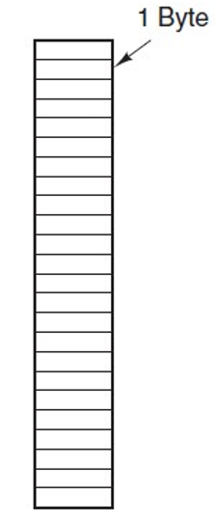
Byte Sequence(Unstructured)
A file is viewed as a linear sequence of bytes (binary data)
The operating system does not interpret the content; it just sees raw bytes.
No structure is imposed by the OS.
Interpretation is up to the application using the file.
A .txt file or .exe file is just a stream of bytes
Example: 01001000 01100101 01101100 01101100 01101111

Slide 11
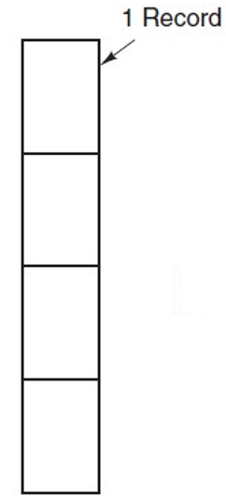
Record Sequence
A file is made up of structured records, each of which may contain multiple fields
Each record is a unit of data (like a row in a table)
Records are usually of fixed size
Common in databases or transaction logs
Example: [EmployeeID: 001][Name: John Smith][Salary: 50000]
File looks like:
Record 1: 001, John Smith, 50000
Record 2: 002, Alice Ray, 48000
Record 3: 003, Omar Khan, 52000

Slide 12
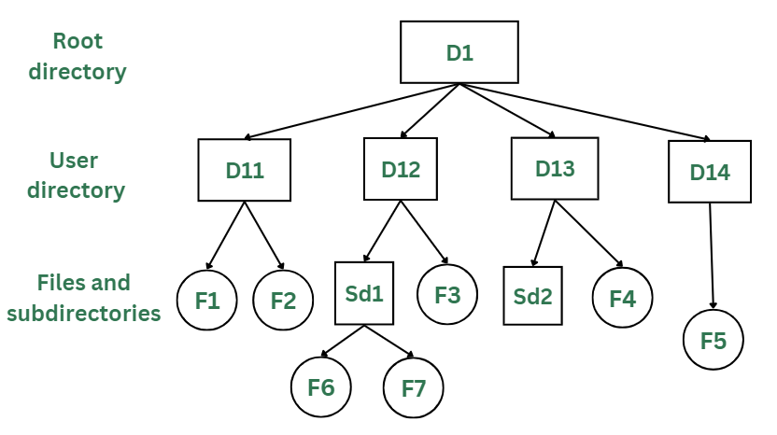
Tree Structure
A hierarchical organization where data is stored and accessed in a tree-like format
Nodes represents data or directories.
Enables fast search, insert, and delete operations
Frequently used in file systems, databases, and XML parsers.

Slide 13
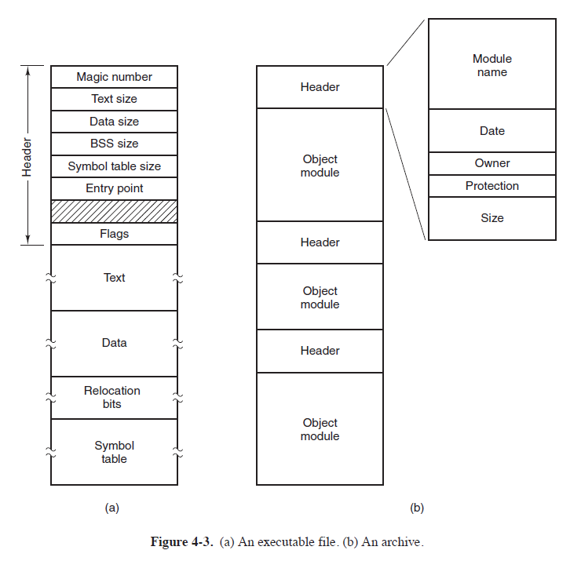
File Types
Operating Systems classify files into types based on content and purpose
The categories or classifications of files based on their content, format, or intended use
The operating system handles different file types differently based on their structure and purpose

Slide 14
Regular files
Most common file type containing user data or application data.
Created and manipulated by user-level programs (editors, compilers).
Not directly related to hardware; purely software-level.
Support operations: read, write, append, and execute.
Example: source code, documents, images, executables.
Can be further divided into ASCII (text) or Binary files.

Slide 15
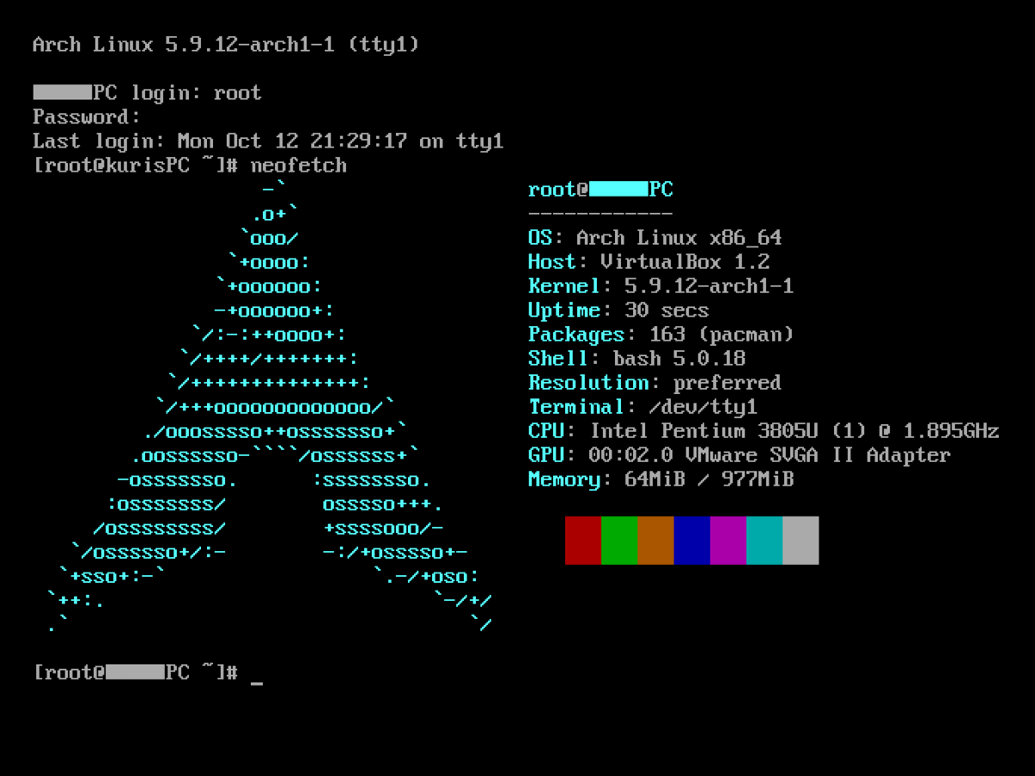
ASCII File
Contains readable characters encoded using ASCII or UTF-8.
Each character is stored as a byte; easy to edit with text editors.
Often line-based, making parsing simpler for software tools.
Larger in size than equivalent binary files for same data.
Easy to share across platforms due to human readability.
Examples: .txt, .csv, .html, source code files

Slide 16
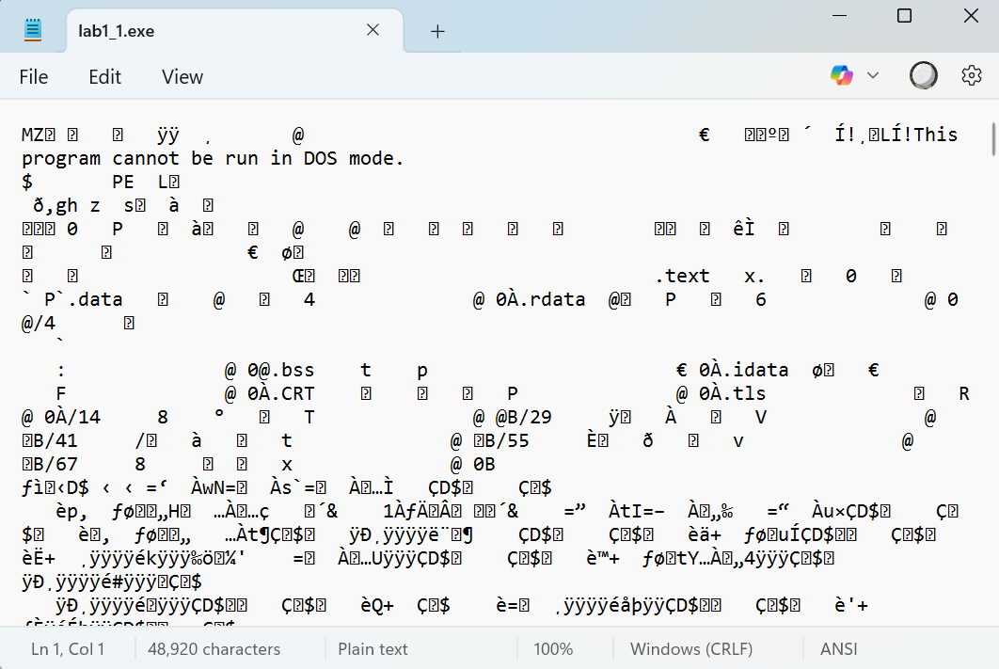
Binary File
Stores data in machine-readable format (0s and 1s)
Cannot be edited directly with text editors
More compact and efficient in storage and processing
Requires specific applications to interpret the contents
Often used for performance-critical applications
Includes images, audio, video, executables, object files.

Slide 17

Directory Files
Special file used to organize and manage files in a hierarchy.
Contains entries like: filename, metadata, pointers to actual files.
Handled by the file system, not by typical user programs.
Allows for logical grouping of files under paths or folders.
Helps enforce access control, naming, and search functionality.
Crucial for hierarchical file systems like Unix, Windows.
Example: /home, /bin

Slide 18
Special Files
Used for OS-level access to hardware devices and virtual resources.
Two types:
Character special files (e.g., keyboard, serial port)
Block special files (e.g., hard disk, USB)
Located typically in /dev in Unix-like systems.
Allow user-level programs to communicate with devices via I/O.
Managed by the OS through device drivers.
Example: /dev/null, /dev/sda, /dev/tty.

Slide 19
Thank You

